Slide 1
Topic 7: Design, Prototyping and Construction (part 1)
SECV2113 Human-Computer Interaction
Faculty of Computing
Universiti Teknologi Malaysia

Slide 2
PROTOTYPING
01
CONCEPTUAL DESIGN
02
CONCRETE DESIGN
03
GENERATING PROTOTYPES
04
CONSTRUCTION
05

Slide 3
Designing with or for People?
Is stakeholder engagement one-way?
Co-design
Emphasises creativity and mutual learning
Often multidisciplinary
Participatory design (Scandinavian version)
Stakeholders are design partners
Co-operative prototyping is important
Community-based design
Scale in terms of numbers and diversity

Slide 4
PROTOTYPING

Slide 5
Prototyping
What is a prototype?
Why prototype?
Different kinds of prototyping
Low fidelity
High fidelity
Compromises in prototyping
Vertical
Horizontal
Final product needs to be engineered

Slide 6
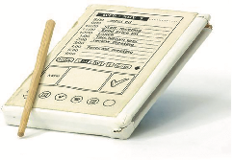
What is a Prototype?
One manifestation of a design that allows stakeholders to interact with it
In other design fields, a prototype is a small-scale model:
A miniature car
A miniature building or town
Source: PalmPilot wooden model © Mark Richards

Slide 7
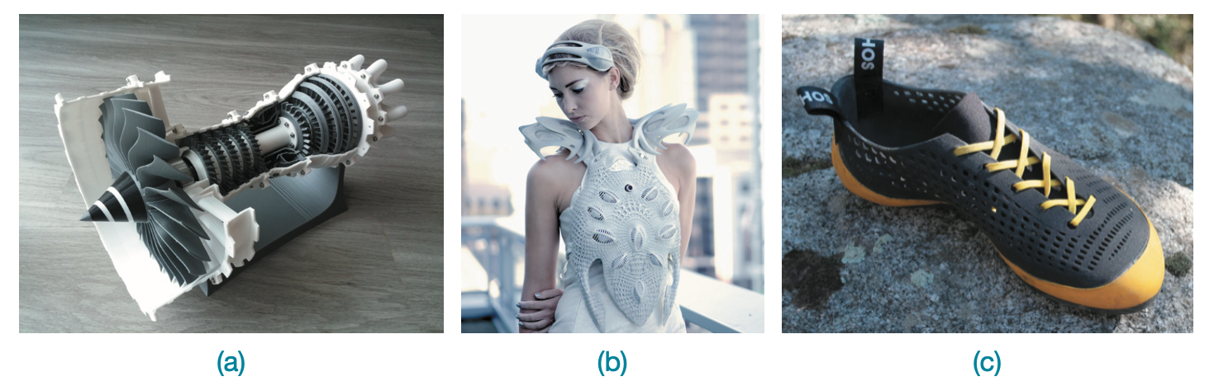
3D Printing Examples
Examples of 3D printing: (a) model jet engine, (b) Synapse Dress by Anouk Wipprecht: embedded with sensors, the wearer can control the dress’s lighting pattern, and (c) custom-made climbing shoes based on a scan of the wearer’s feet
Source: (a) Catiav5ftw / MakerBot Industries, LLC / CC BY-NC 4.0, www.thingiverse.com/thing:392115. Licensed under CC-BY-3.0, (b) ANOUK WIPPRECHTSYNAPSE DRESS created for Intel in 2014, www.niccolocasas.com/ SYNAPSE-DRESS, and (c) Photo Credits: ATHOS

Slide 8
What is a Prototype in Interaction Design (ID)?
Among other things an interaction design prototype can be:
A series of screen sketches
A storyboard, for example, a cartoon-like series of scenes
A PowerPoint slide show
A video simulating the use of a system
A lump of wood (for instance, the PalmPilot)
A loosely connected set of electronic elements
An animation of product use
A piece of software with limited functionality written in the target language or in another language

Slide 9
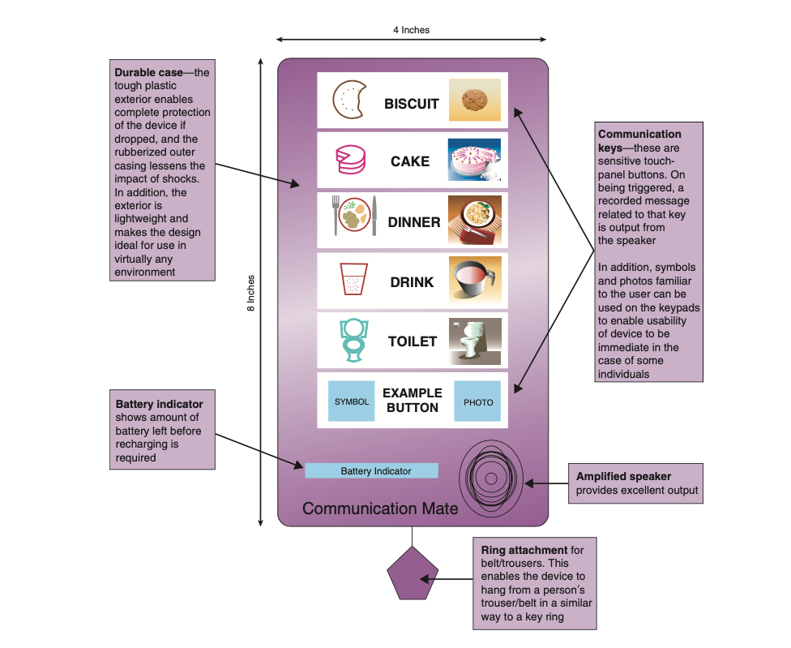
Example ID Prototype
A paper-based prototype of a handheld device to support an autistic child
Used courtesy of Sigil Khwaja

Slide 10
What to Prototype?
Technical issues
Work flow, task design
Screen layouts and information display
Difficult, controversial, critical areas

Slide 11
Why Prototype?
Evaluation and feedback are central to interaction design
Stakeholders can see, hold, and interact with a prototype more easily than a document or a drawing
Team members can communicate effectively
Ideas can be tested out
Prototyping encourages reflection: an important aspect of design
Prototypes answer questions and support designers in choosing between alternatives

Slide 12
Low-fidelity Prototyping
Uses a medium which is unlike the final medium, for example, paper or cardboard
Is simple, quick, cheap & easily changed
Examples:
Sketches of screens and task sequences
Index cards or sticky notes
Storyboards
Wizard-of-Oz

Slide 13
Example 1: Storyboards
A series of sketches showing how someone might progress through a task using the product
Often used with scenarios, bringing in more detail and a chance to role play

Slide 14
Example 2: Sketching
Low-fidelity prototyping often relies on sketching
Don’t be inhibited about drawing ability — Practice simple symbols

Slide 15
Example 3: Index Cards
Index cards (3 x 5 inches)
Each card represents one element of interaction
In evaluation, can step through the cards

Slide 16
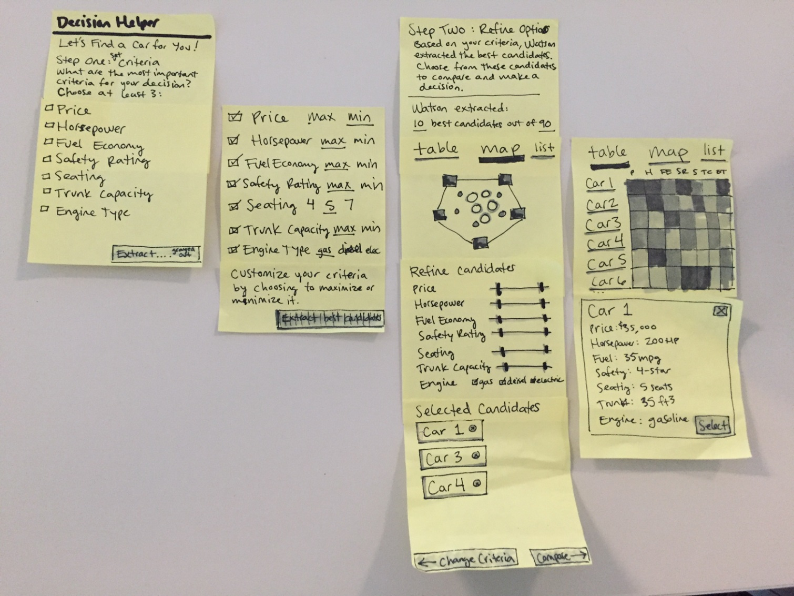
Example 4: Post-it Notes
Low-fidelity paper prototypes don't look like the final product
Source: https://www.oreilly.com/ideas/prototyping-physical-digital-products

Slide 17
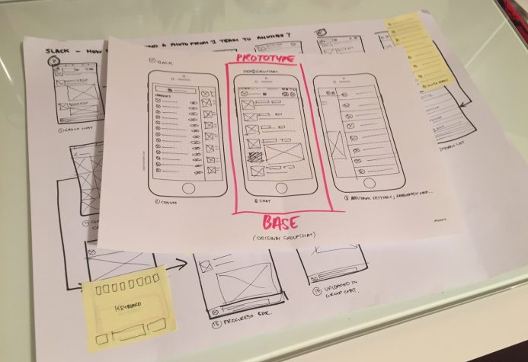
Example 5: Wireframe/Paper
Paper prototypes can assist in documentation. Notes and revisions will support designers and developers when they will create an actual product
Source: https://theblog.adobe.com/prototyping-difference-low-fidelity-high-fidelity-prototypes-use

Slide 18
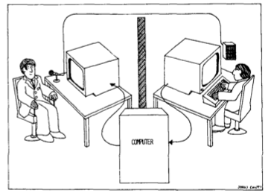
Example 6: Wizard-of-Oz
The participant thinks they are interacting with a computer, but a human is responding to output rather than the system
Usually done early in design to understand peoples’ expectations

Slide 19
High-fidelity Prototyping
Uses materials that would be in the final product
Prototype looks more like the final system than a low-fidelity version
High-fidelity prototypes can be developed by integrating existing hardware and software components
Danger that people think they have a complete system…see compromises

Slide 20
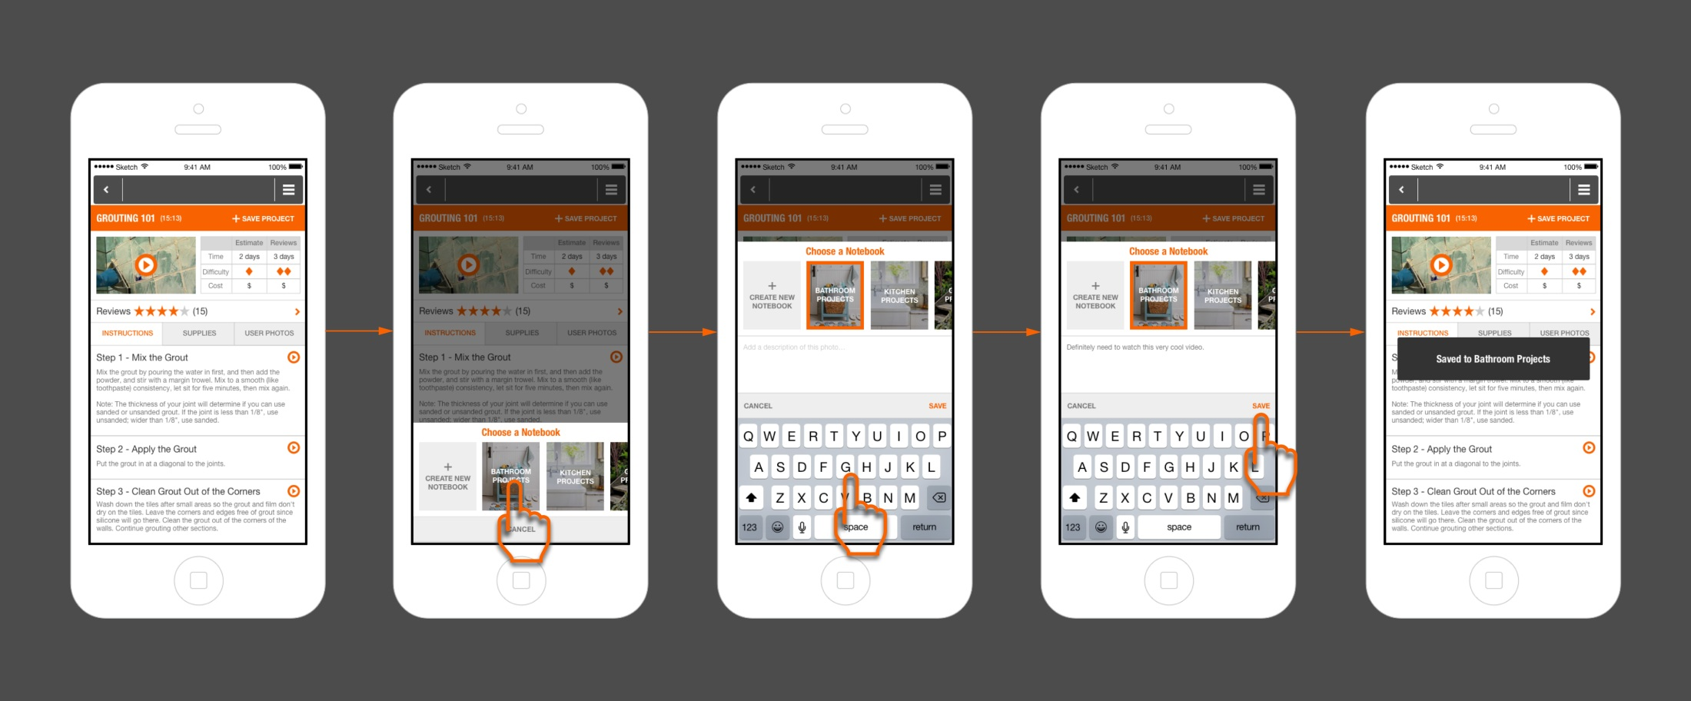
Example: Mobile App
In the design process of high-fidelity prototyping, you need to work closely with the interaction designers to design a product as simple and easy to use as possible
Source: https://www.mockplus.com/blog/post/different-stages-of-prototyping

Slide 21
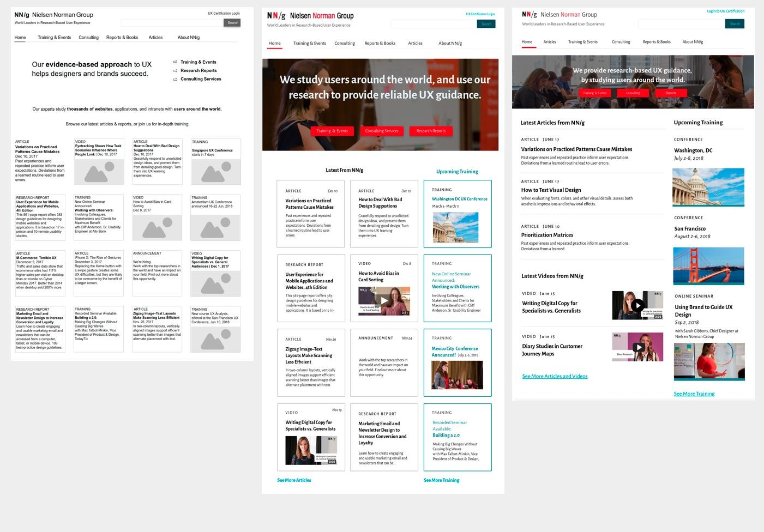
Evolution of Prototypes
Iterative design process evolved from black–and–white wireframes for content planning to multiple versions of high-fidelity visual mockups created with cloud-based prototyping tools
Sourcehttps://www.nngroup.com/articles/case-study-iterative-design-prototyping/

Slide 22
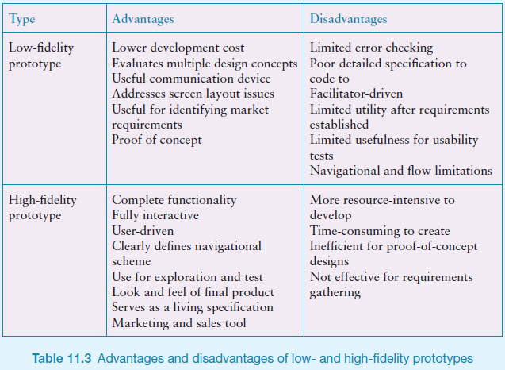
Advantages and Disadvantages

Slide 23
Compromises in Prototyping
Prototyping involve compromises
For software-based prototyping, maybe there is a slow response? sketchy icons? limited functionality?
In-the-wild prototypes are operational but not necessarily robust
Two common types of compromise:
Horizontal: wide range of functions, with little detail
Vertical: a lot of detail for only a few functions
Other common compromise: robust vs changeable
Beware of compromises in prototypes as final product needs to be engineered
Read more: https://www.youtube.com/watch?v=HJmK_wuZWp4

Slide 24
CONCEPTUAL
DESIGN

Slide 25
Conceptual Design
Transforms user requirements/needs into a conceptual model
A conceptual model is an outline of what people can do with a product and what concepts are needed to understand and interact with it
Understand problem space and current requirements; empathize with users
Creativity and brainstorming techniques
Mood board may capture desired feel
Consider alternatives: scenarios and prototyping helps

Slide 26
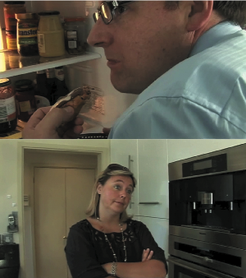
Building Scenarios

Slide 27
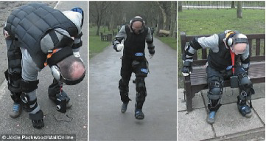
Emphathising with Users – The Third Age Suit
Source: Ford Motor Company

Slide 28
Choosing an Interface Metaphor
Interface metaphors combine familiar knowledge with new knowledge in a way that will help the user understand the product.
Three steps:
understand functionality → identify potential problem areas → generate metaphors
Evaluate metaphors:
How much structure does it provide?
How much is relevant to the problem?
Is it easy to represent?
Will the audience understand it?
How extensible is it?

Slide 29
Considering Interaction and Interface Types
Which interaction type?
How the user invokes actions
Instructing, conversing, manipulating, exploring, or responding
Do different interface types provide insight?
Shareable, tangible, augmented reality, and so forth

Slide 30
Expanding the Initial Conceptual Model
What functions will the product perform?
What will the product do and what will the user do?
How are the functions related to each other?
Sequential or parallel?
Categorisations, for example, all actions related to privacy on a smartphone
What information is needed?
What data is needed to perform the task?
How is this data to be transformed by the system?

Slide 31
CONCRETE
DESIGN

Slide 32
Concrete Design
Difference between conceptual and concrete is emphasis
Many aspects to concrete design
Color, icons, buttons, interaction devices, and so on
User characteristics and context
Inclusiveness, input, and output modes
Accessibility
Web Content Accessibility Guidelines
Localisation and internationalisation
Language, navigation, icons, and metaphor
Indigenous knowledge and perspectives

Slide 33
GENERATING
PROTOTYPES

Slide 34
Generating Prototypes
Generate a storyboard from a scenario
Break down scenario into steps
Create a scene for each step
Sketching out a storyboard prompts designers to think about design issues
Generate a card-based prototype from a storyboard or from a use case
Consider each step in the use case – what interaction element is needed
Draw a card that captures it

Slide 35
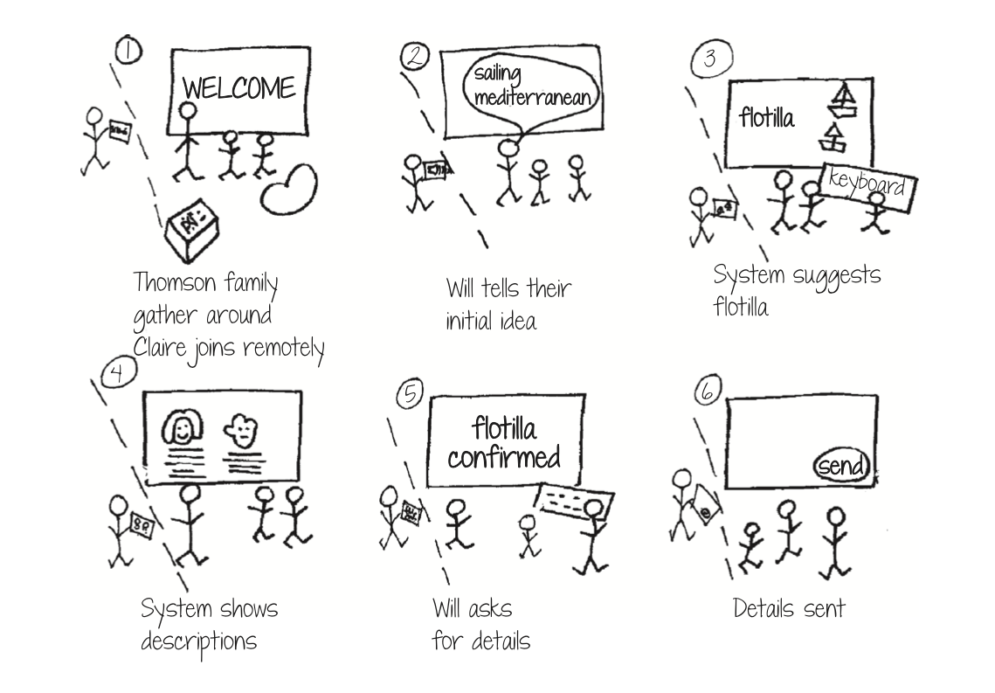
Generating Storyboard

Slide 36
Generating Card-based Prototype

Slide 37
Mapping the Overall Experiences
Combination of personas, prototypes, or stickies to model the overall experience
Visual representation called:
Design map
Customer journey map (see part 2)
Experience map
Two common representations
Wheel
Timeline
User flows focus on screen content and design, particularly used for mobile devices

Slide 38
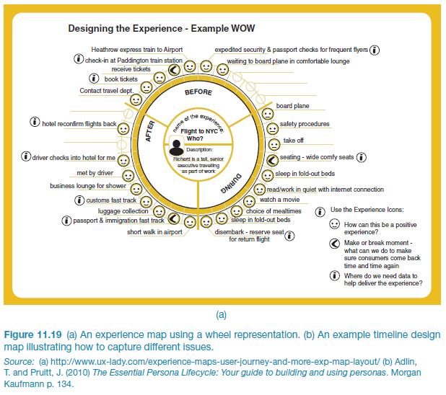
An experience map drawn as a Wheel
Source: LEGO

Slide 39
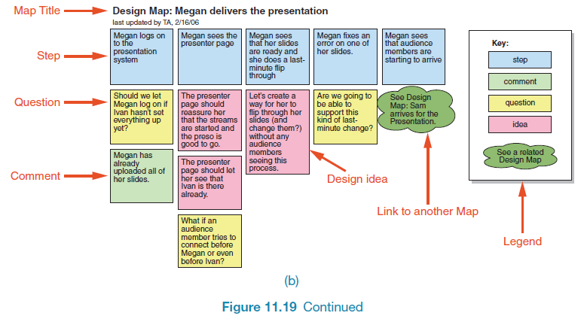
An experience map drawn as a Timeline
Source: Adlin and Pruitt (2010), p134. Used courtesy of Morgan Kaufmann.

Slide 40
CONSTRUCTION

Slide 41
Construction: Physical Computing
Build and code prototypes using electronics
Toolkits available include
Arduino
LilyPad (for fabrics)
Raspberry Pi
BBC micro:bit
MaKey MaKey
Designed for use by a wide range of people

Slide 42
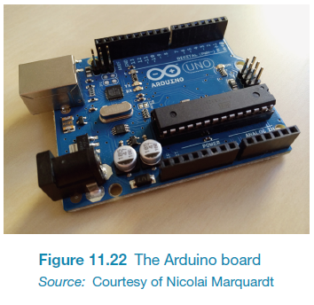
Physical Computing Kits: Arduino Board
Source: Used courtesy of Dr. Nicolai Marquardt

Slide 43
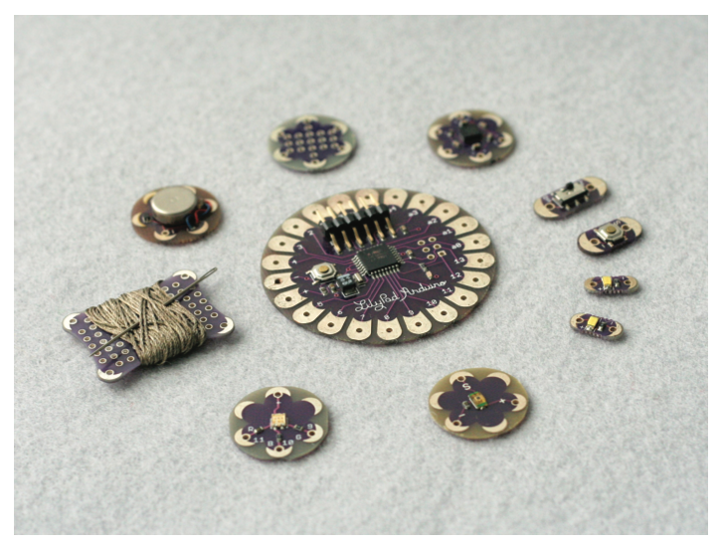
Physical Computing Kits: Lilypad Arduino
Source: Courtesy of Leah Beuchley

Slide 44
Physical Computing Kits: Micro:bit
Source: micro:bit. Used courtesy of Micro:bit Foundation

Slide 45
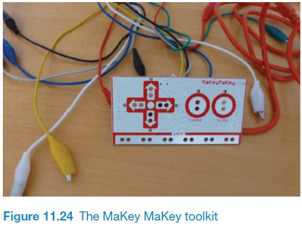
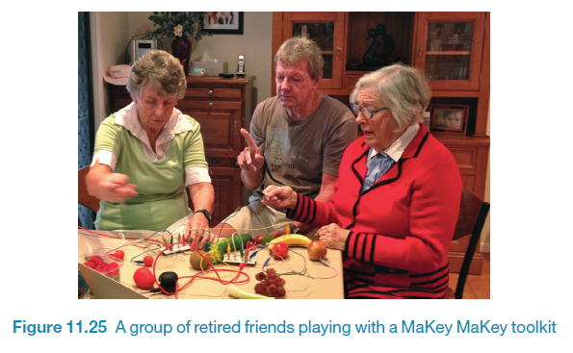
Physical Computing Kits: MaKey MaKey

Slide 46
Construction: SDKs
Software Development Kits
Programming tools and components to develop for a specific platform, for example, iOS
Includes: IDE, documentation, drivers, sample code, and application programming interfaces (APIs)
Makes development much easier
Examples:
Amazon’s Alexa Skills Kit for voice-based services
Apple’s ARKit for augmented reality

Slide 47
Summary
Prototyping may be low fidelity (such as paper-based) or high fidelity (such as software-based)
Ready-made software and hardware helps create prototypes
Two aspects to design: conceptual and concrete
Conceptual design develops an outline of what people can do and what concepts are needed to understand the product.
Concrete design specifies design details, for example, layout or navigation
Three approaches to develop an initial conceptual model: interface metaphors, interaction styles, and interface styles.
Expand an initial conceptual model by considering whether product or user performs each function, how those functions are related, and what information is required to support them
Scenarios and prototypes can be used to explore design ideas
Physical computing kits and software development kits facilitate the transition from design to construction

